Slide 1


Flight Delay prediction
By Sowjanya Deva

Slide 2


Work Flow
Collect data
Understand flight data
Prepare data for modeling
Create predictive models
Measure models ability to predict delays
Evaluate findings
Make recommendations

Slide 3
Problem statement :
The problem at hand is to develop a predictive model that accurately forecasts flight delays. Flight delays cause inconvenience to passengers, impact airline operations, and result in financial losses.
Solution:
By predicting delays in advance, airlines can proactively manage their resources, minimize disruptions, and improve customer satisfaction.
The objective is to build a machine learning model that can accurately predict the probability of flight delays based on various factors such as historical flight data, weather conditions, airport congestion, and airline-specific information. The model should consider both scheduled and actual departure and arrival times to account for real-time changes.

Slide 4
Data Source
Data Source: https://dataverse.harvard.edu/dataset.xhtml?persistentId=doi:10.7910/DVN/HG7NV7
Data content :
Size: 687.28MB
Rows: 7.4M
Columns: 36

Slide 5

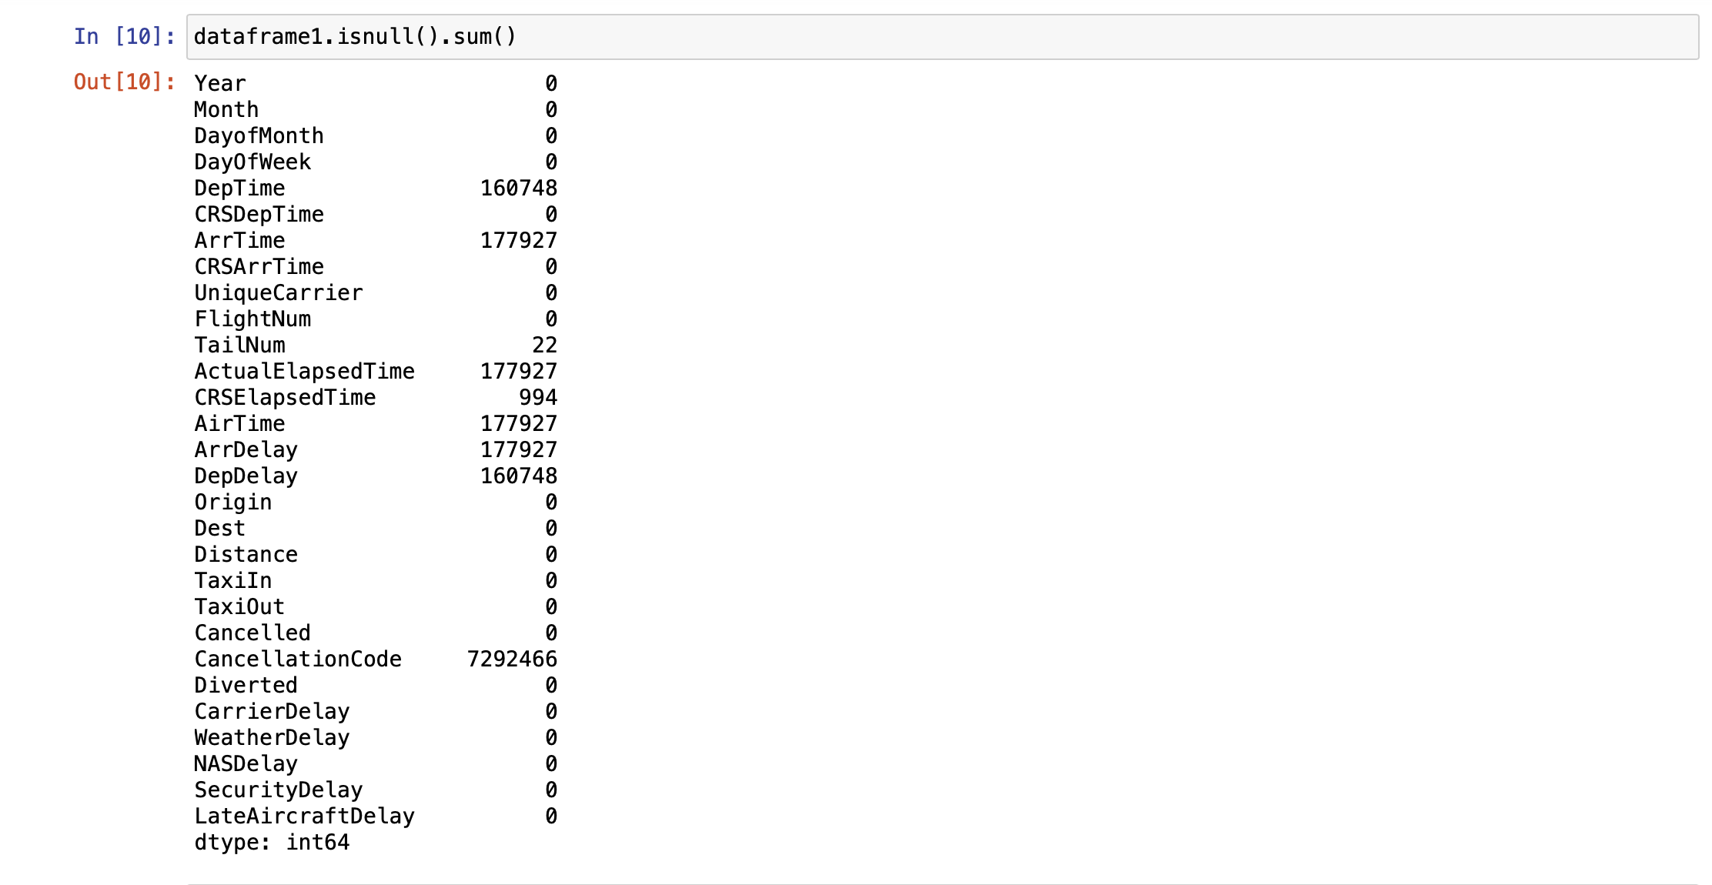
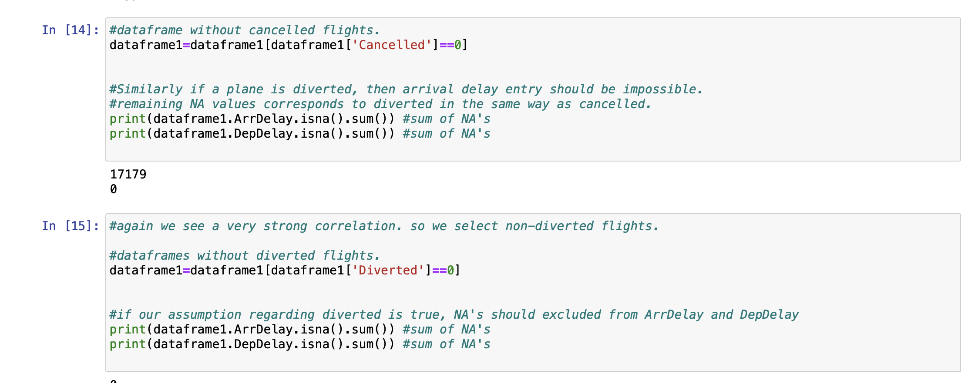
Data Preprocessing :
Checking the NULL values
Creating a dataframe by excluding the diverted and cancelled flights since we are dealing with flight delay

Slide 6
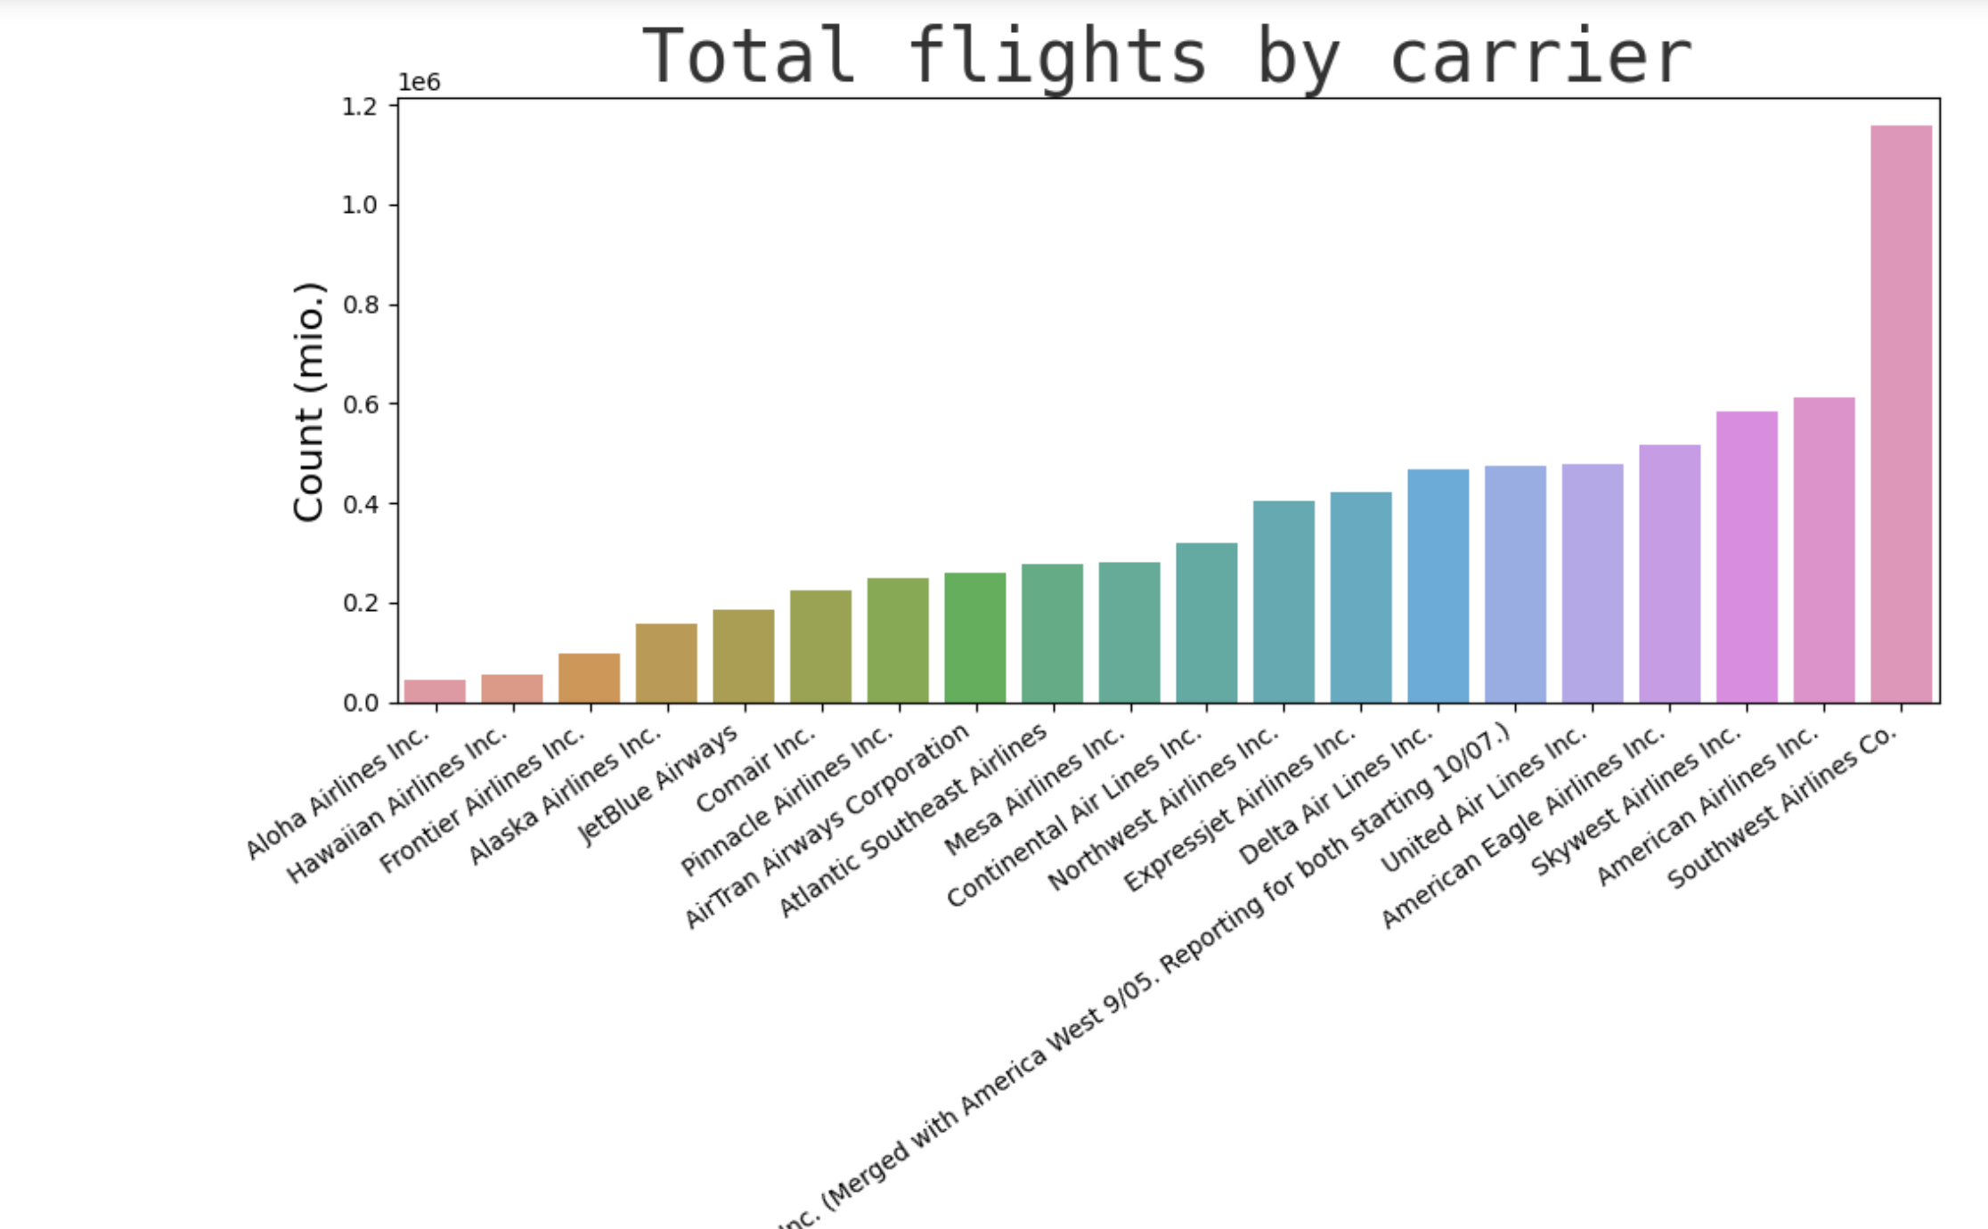
Visualization

Slide 7
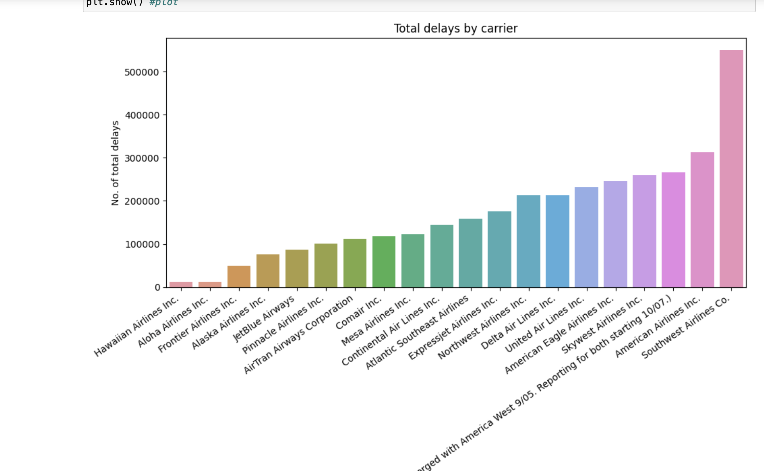

Slide 8
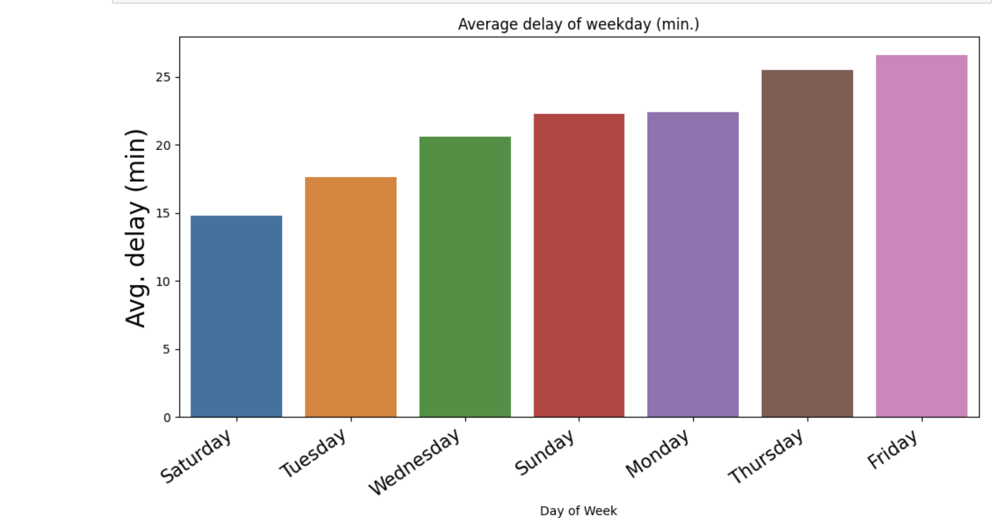
When is the best day of the week to fly to minimise delays?
From the above analysis Saturday is the best day to fly.

Slide 9
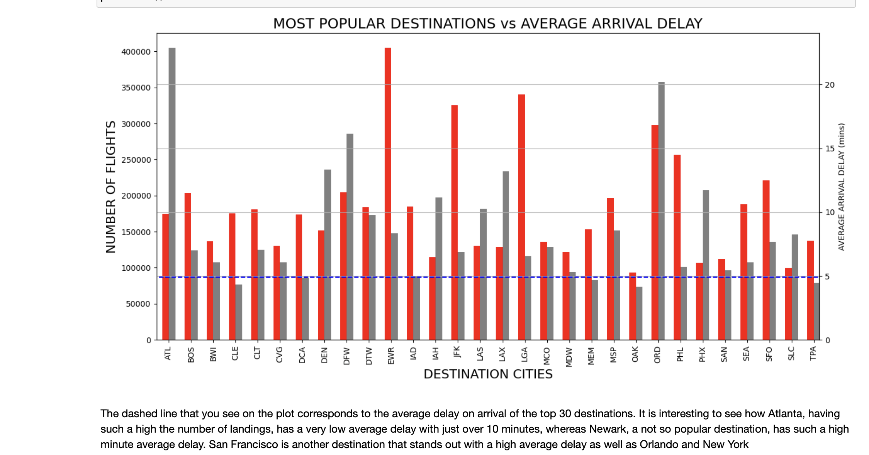
Most Popular Destination with Average Arrival Delays?¶

Slide 10
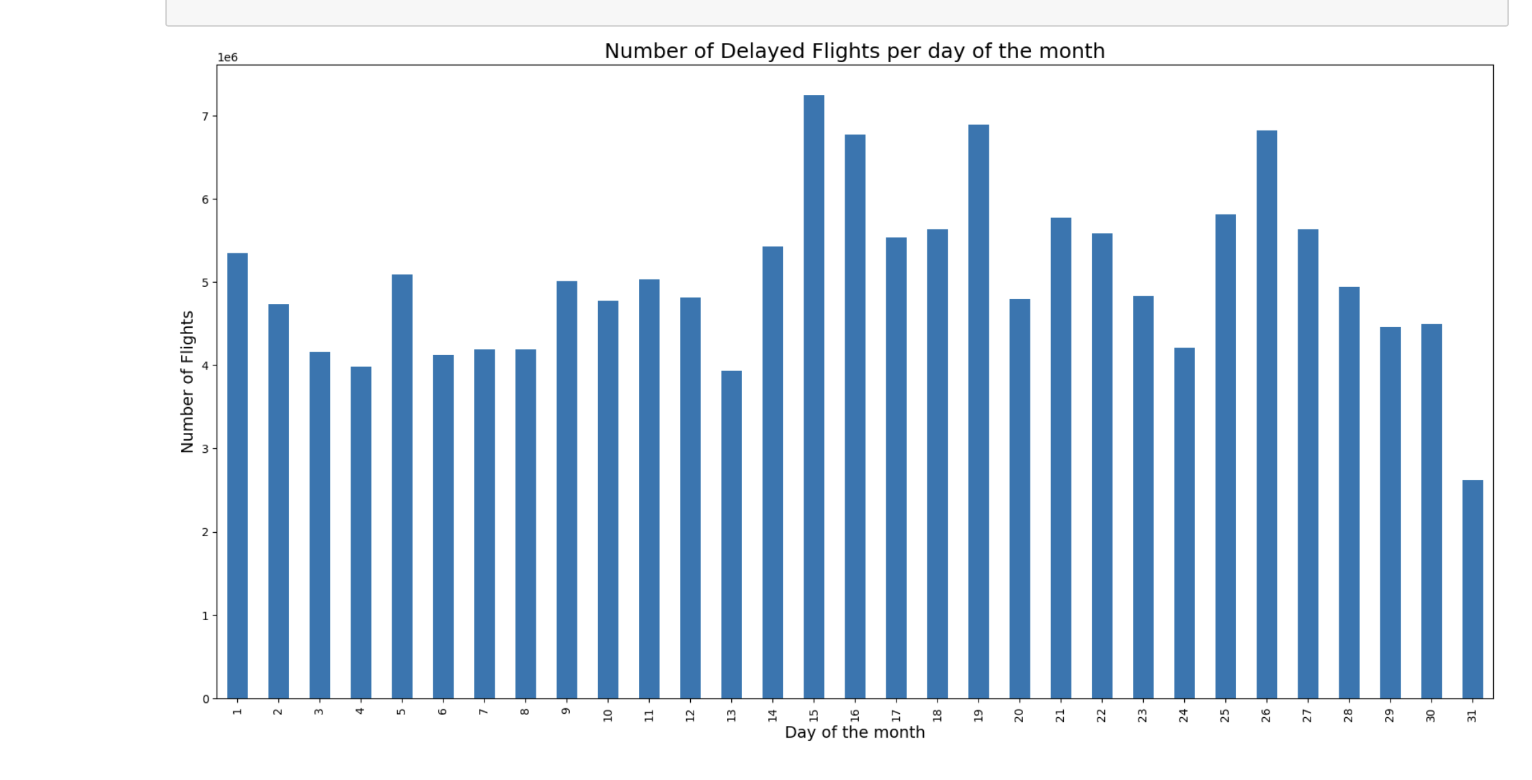
Is there a better day to travel?
It seesms like Last day of the month and middle of the month are the best days to travel.

Slide 11
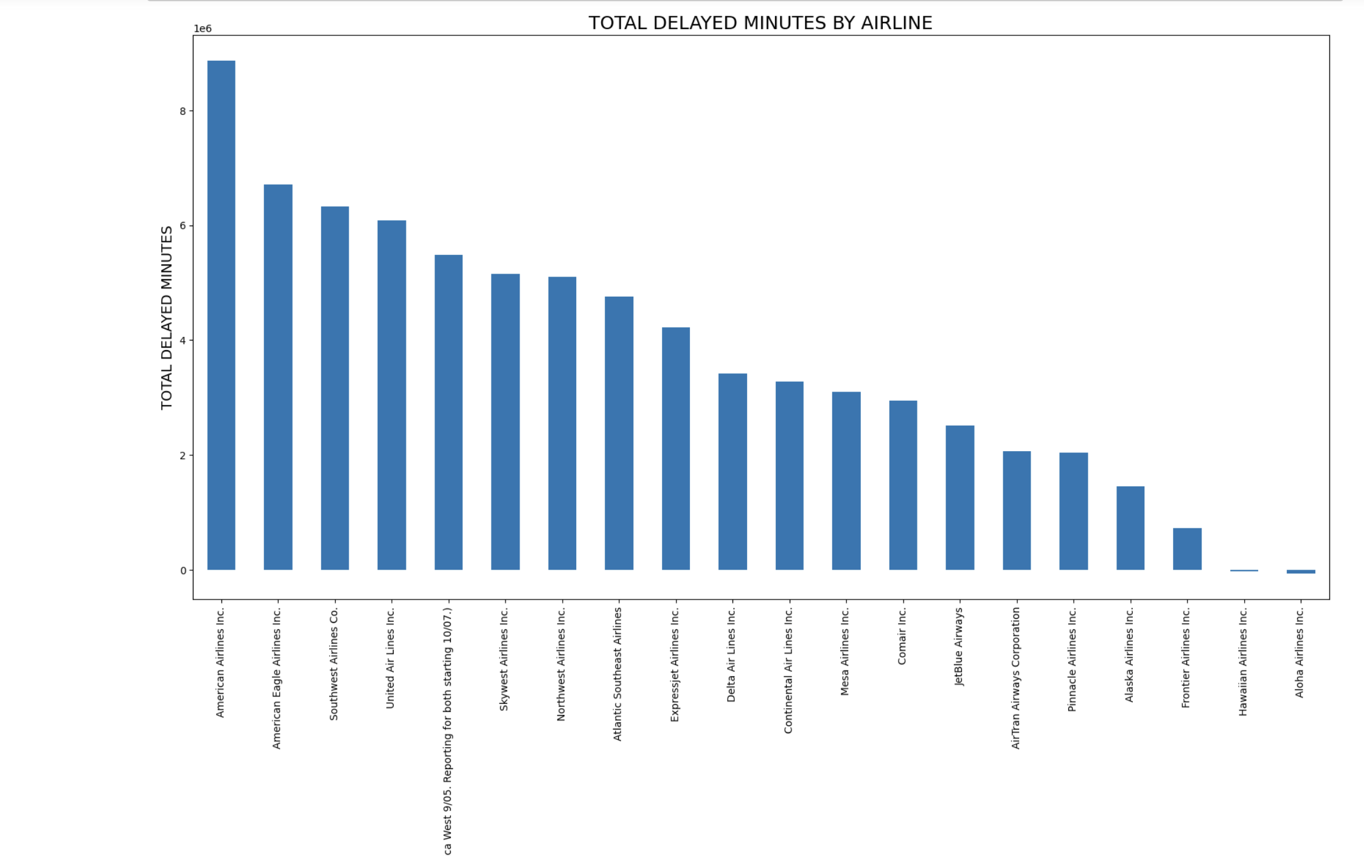
Total Minutes Delayed by Airline?

Slide 12
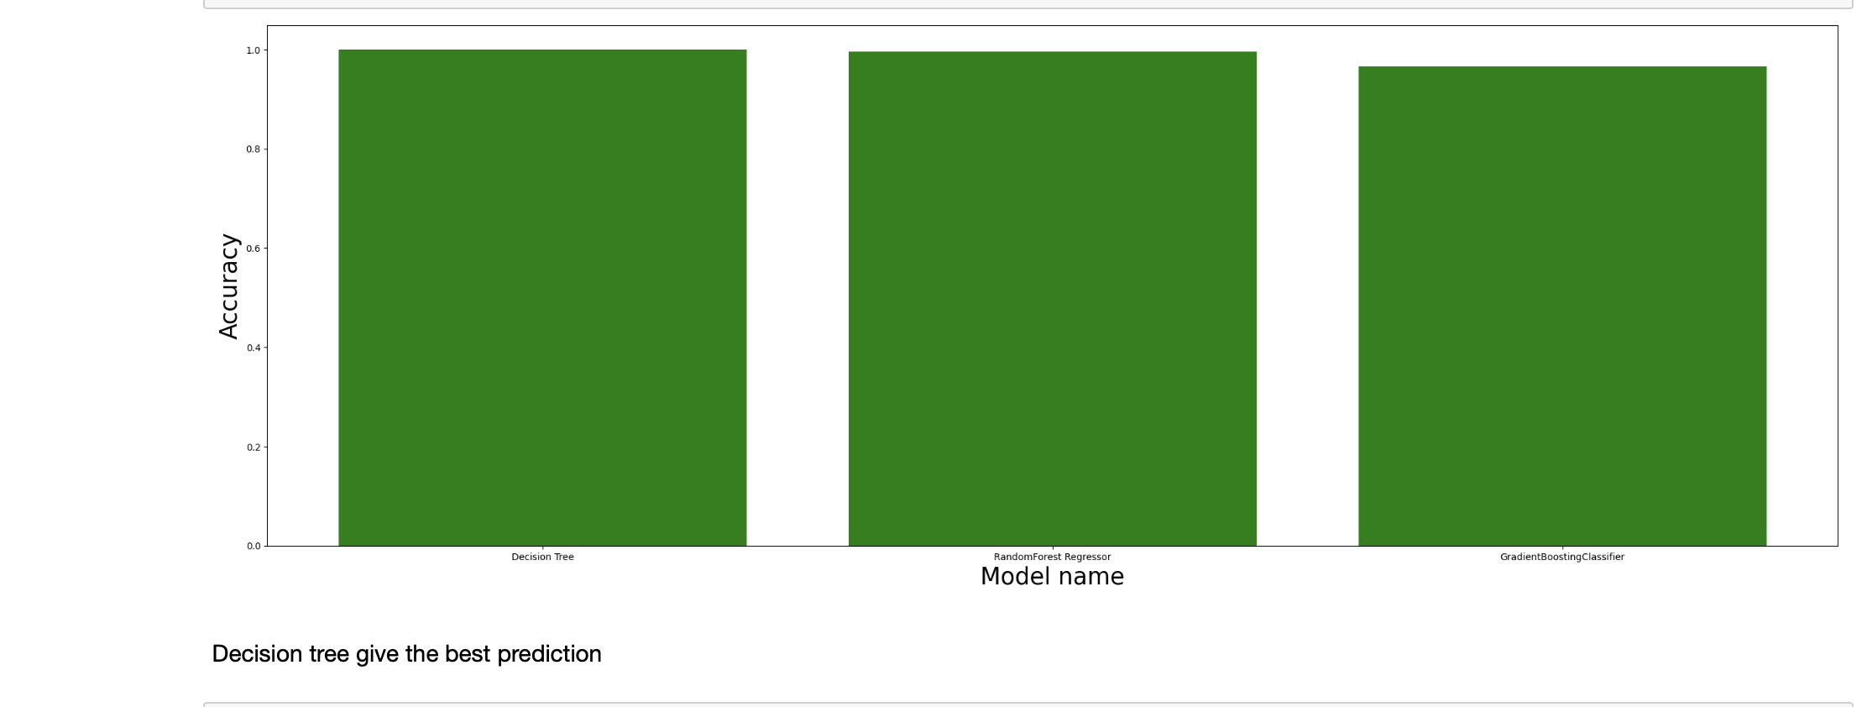
Comparing the predicting models

Slide 13
Thank you

